Slide 1
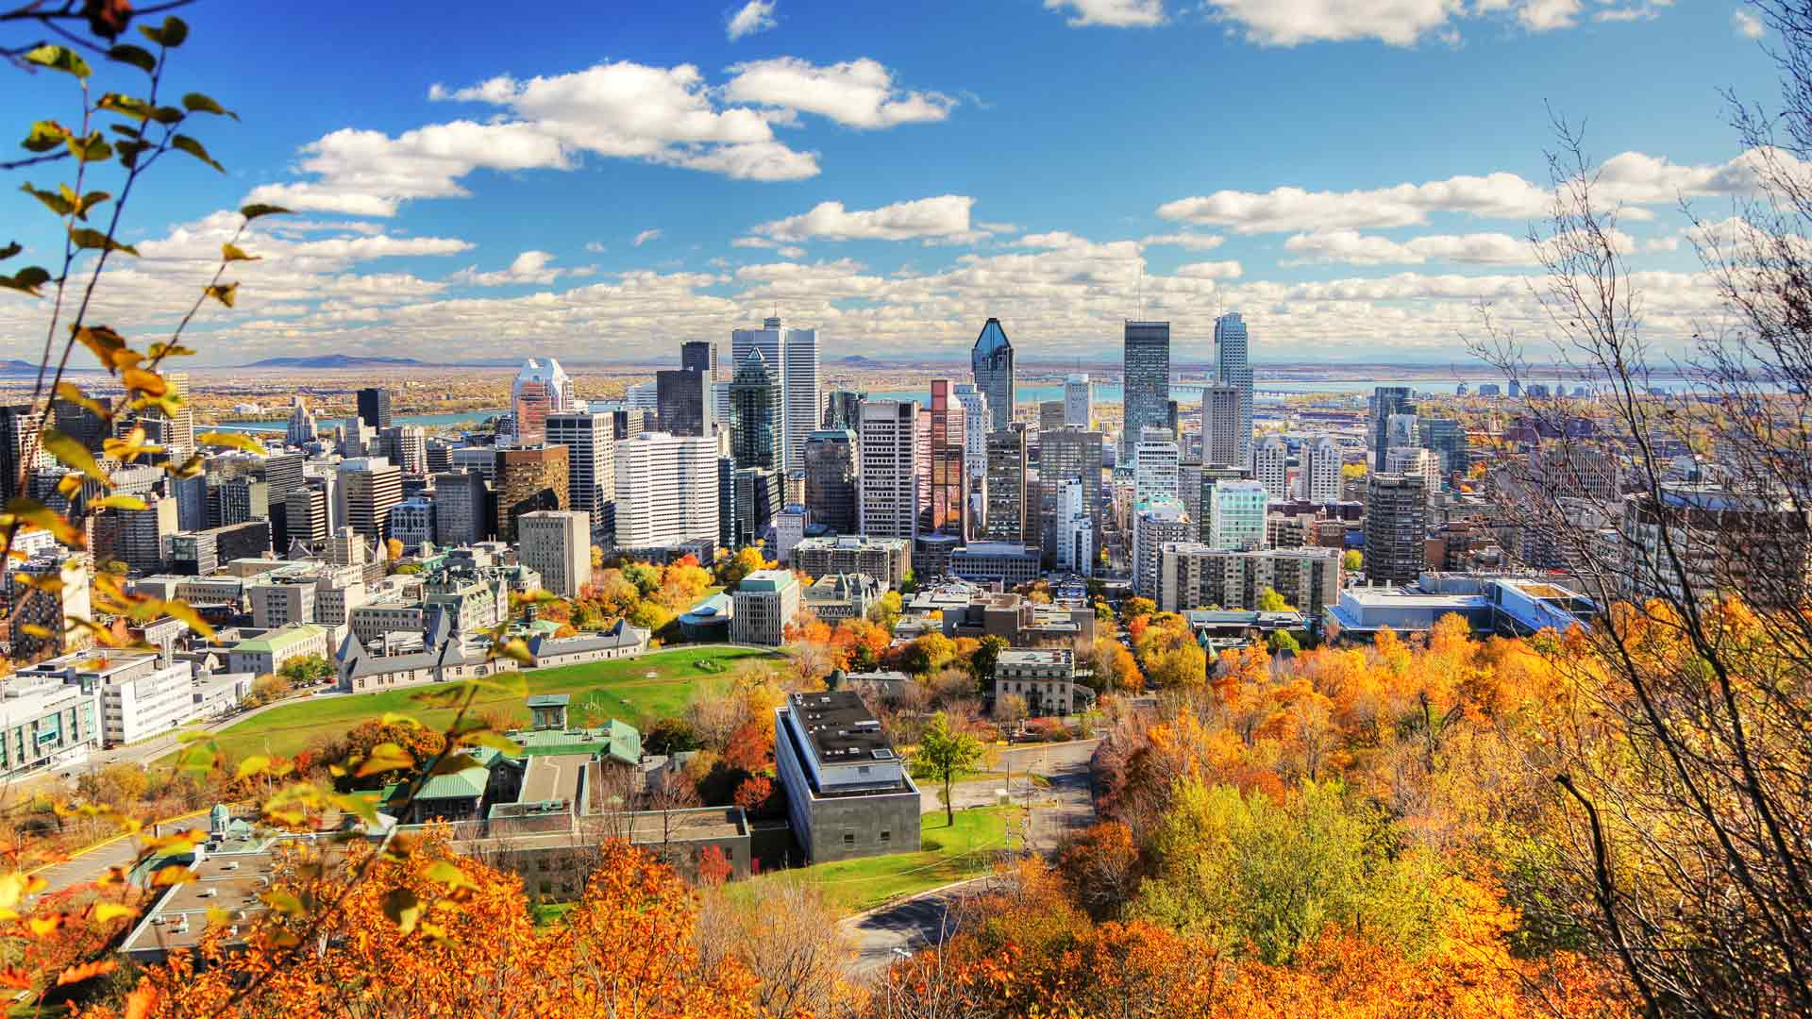
Battle of Neighborhoods
Live in Montreal - by Adil Ezzaam

Slide 2
Selecting the right place to live in Montreal
Live near venues that fit our preferences. The variety of venues tend to likely be where the population is more dense.
Find a peaceful place to live, with the least criminality. Least populated neighborhoods have less criminality.
Be able to afford where you want to live. Westmount and surroundings are more likely to be expensive while being in the middle of everything(rich amount of restaurants and other venues). Spots in the west island are also pricey but less populated and have less accessibility to services.

Slide 3
Which data
The set of data required for this analysis covers boroughs details pulled from Wikipedia and the jmacman12.carto.com website(geojson).
Venues per neighborhoods are gathered from Foursquare API. We will request the data within a predefined radius for each neighborhood.
Criminality data from donnees.montreal.ca/ville-de-montreal/actes-criminels which we will append neighborhoods.
Census data of Montreal which includes Real Estate price, Population and density and income data. This dataset be used cautiously since it’s outdated(2016).

Slide 4
Which methods
We will use Python on Jupyter notebook, on which we will perform all analysis. There’s many libraries involved but we will focus on the essential ones.
Pandas library will be used to do all datasets manipulation and cleaning.
Using BeautifulSoup library helps on pulling data from HTML pages.
Folium library will permit us to place our data on a map covering the Montreal island.
We will perform Clustering as a Machine Learning method. KMeans is used for clustering through Sklearn library.

Slide 5
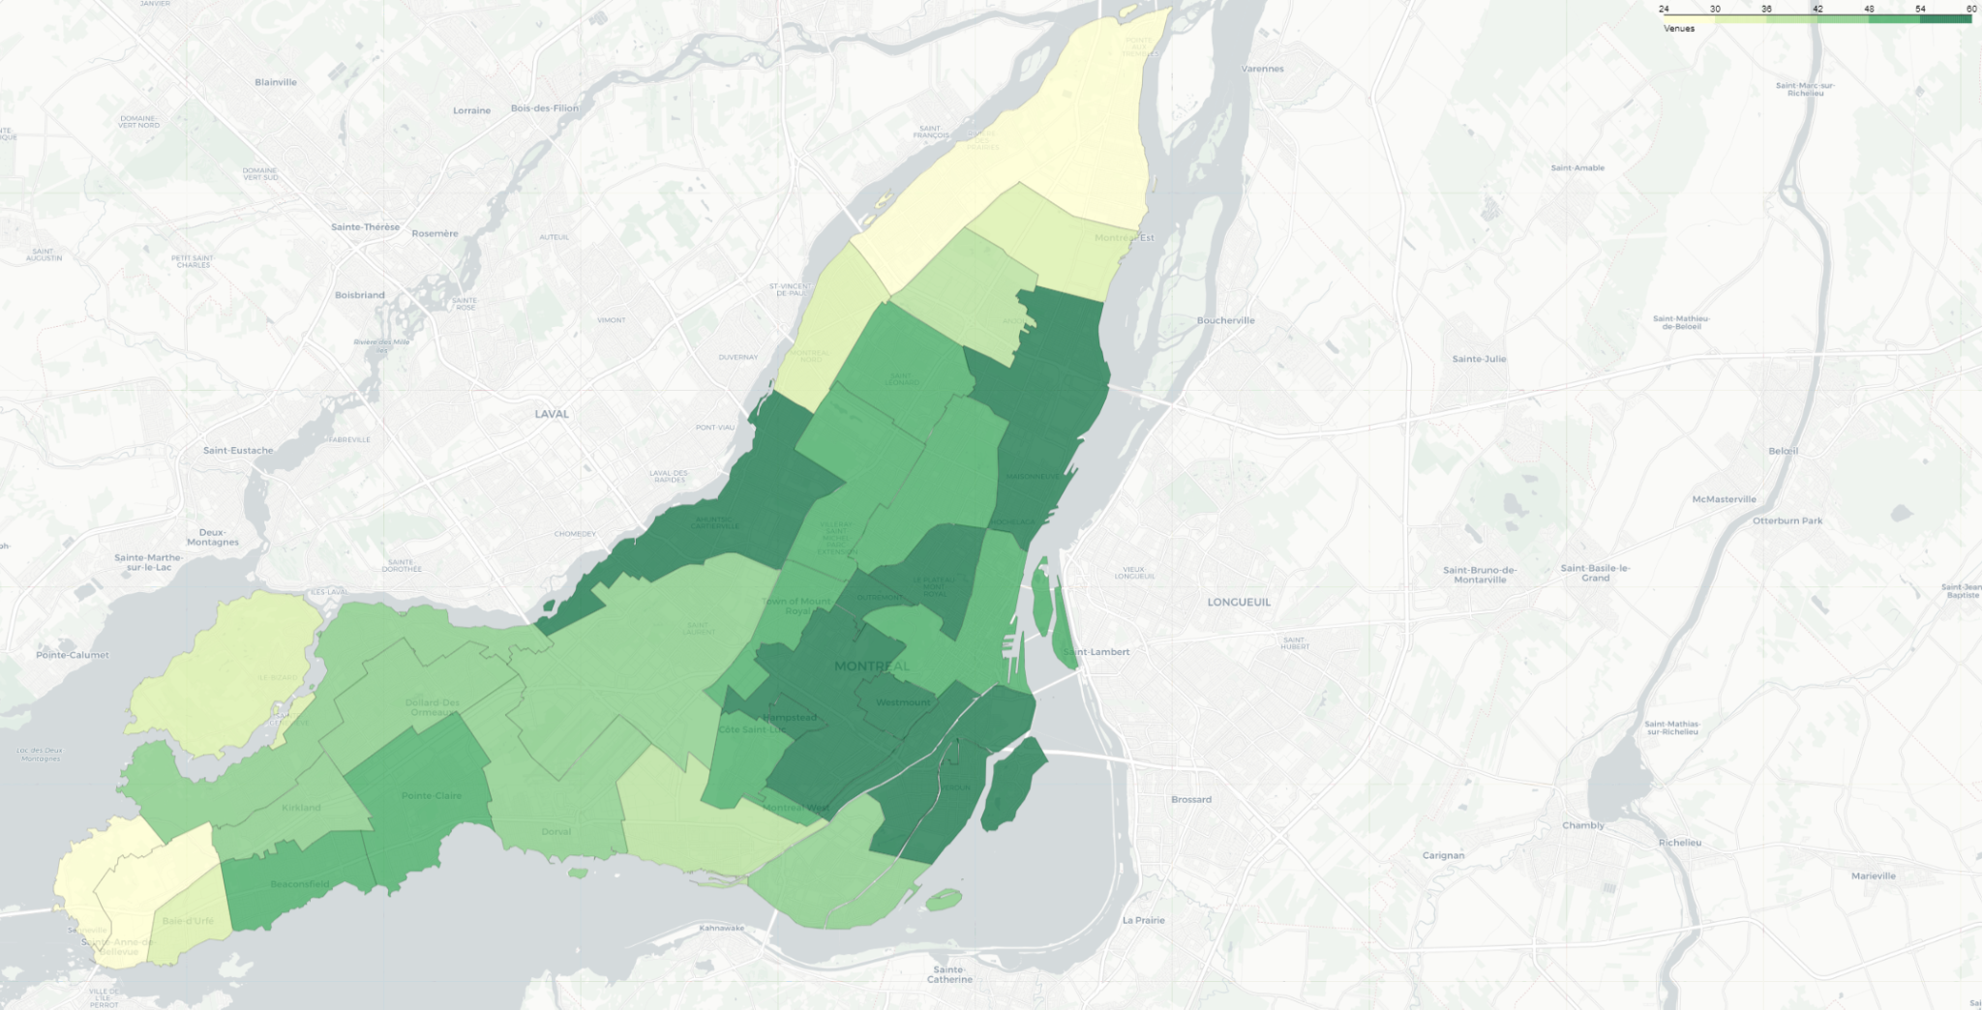
Venues density

Slide 6
Venues density per Neighborhoods
Neighborhoods with most venues
Neighborhood Total
westmount 62
verdun 58
hampstead 57
ville-marie 57
mont-royal 57
Neighborhoods with least venues
Neighborhood Total
senneville 18
sainte-anne-de-bellevue 20
baie d'urfe 20
riviere-des-prairies-pointe-aux-trembles 24
l'ile-bizard-sainte-genevieve 26
While Neighborhoods with most venues are part of or near the downtown area of Montreal. Although for the least, the neighborhoods are on the edges of the city. This correlates a lot with the population and density.

Slide 7
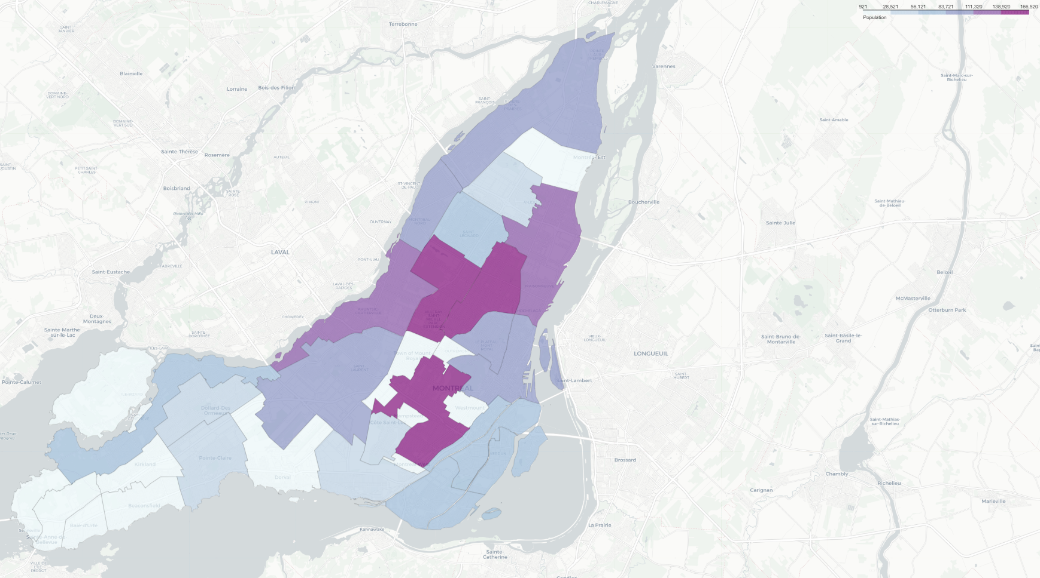
Population

Slide 8
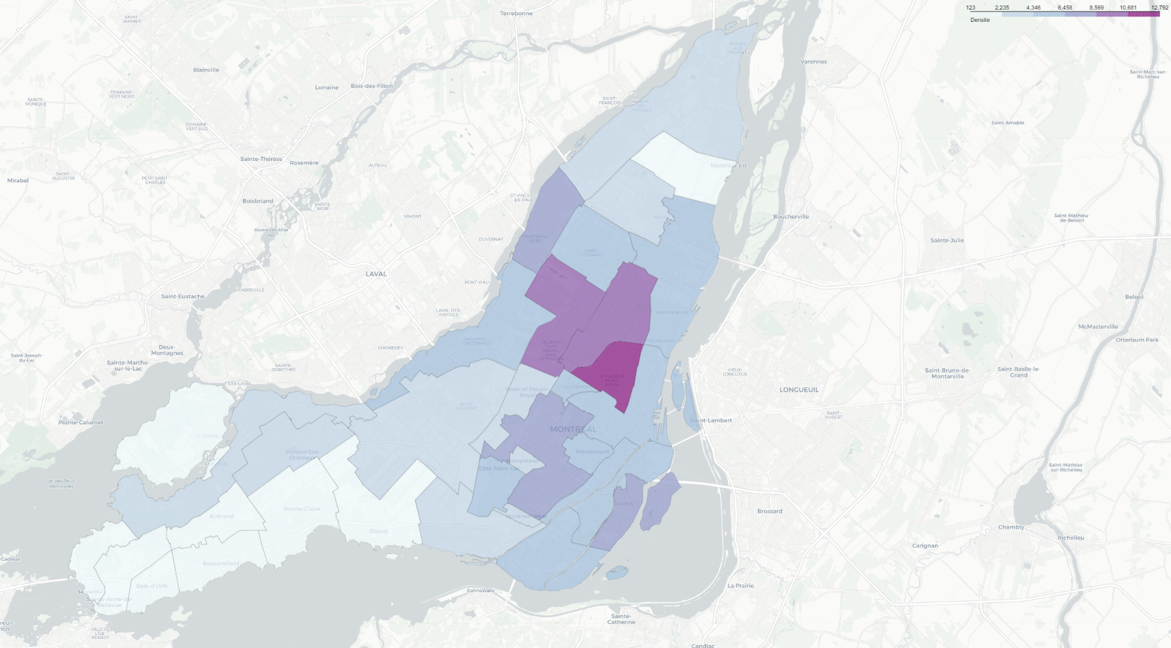
Densite

Slide 9
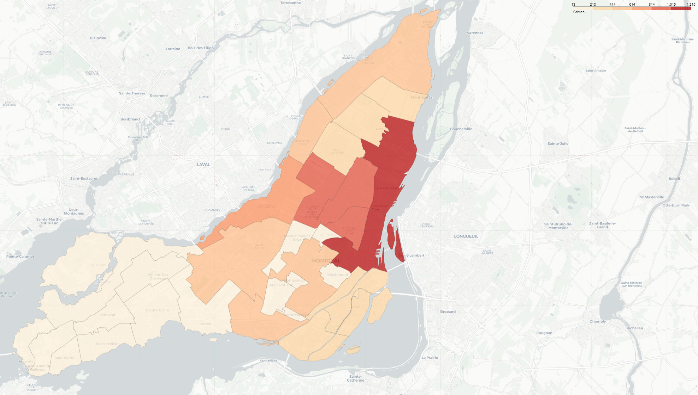
Crimes

Slide 10
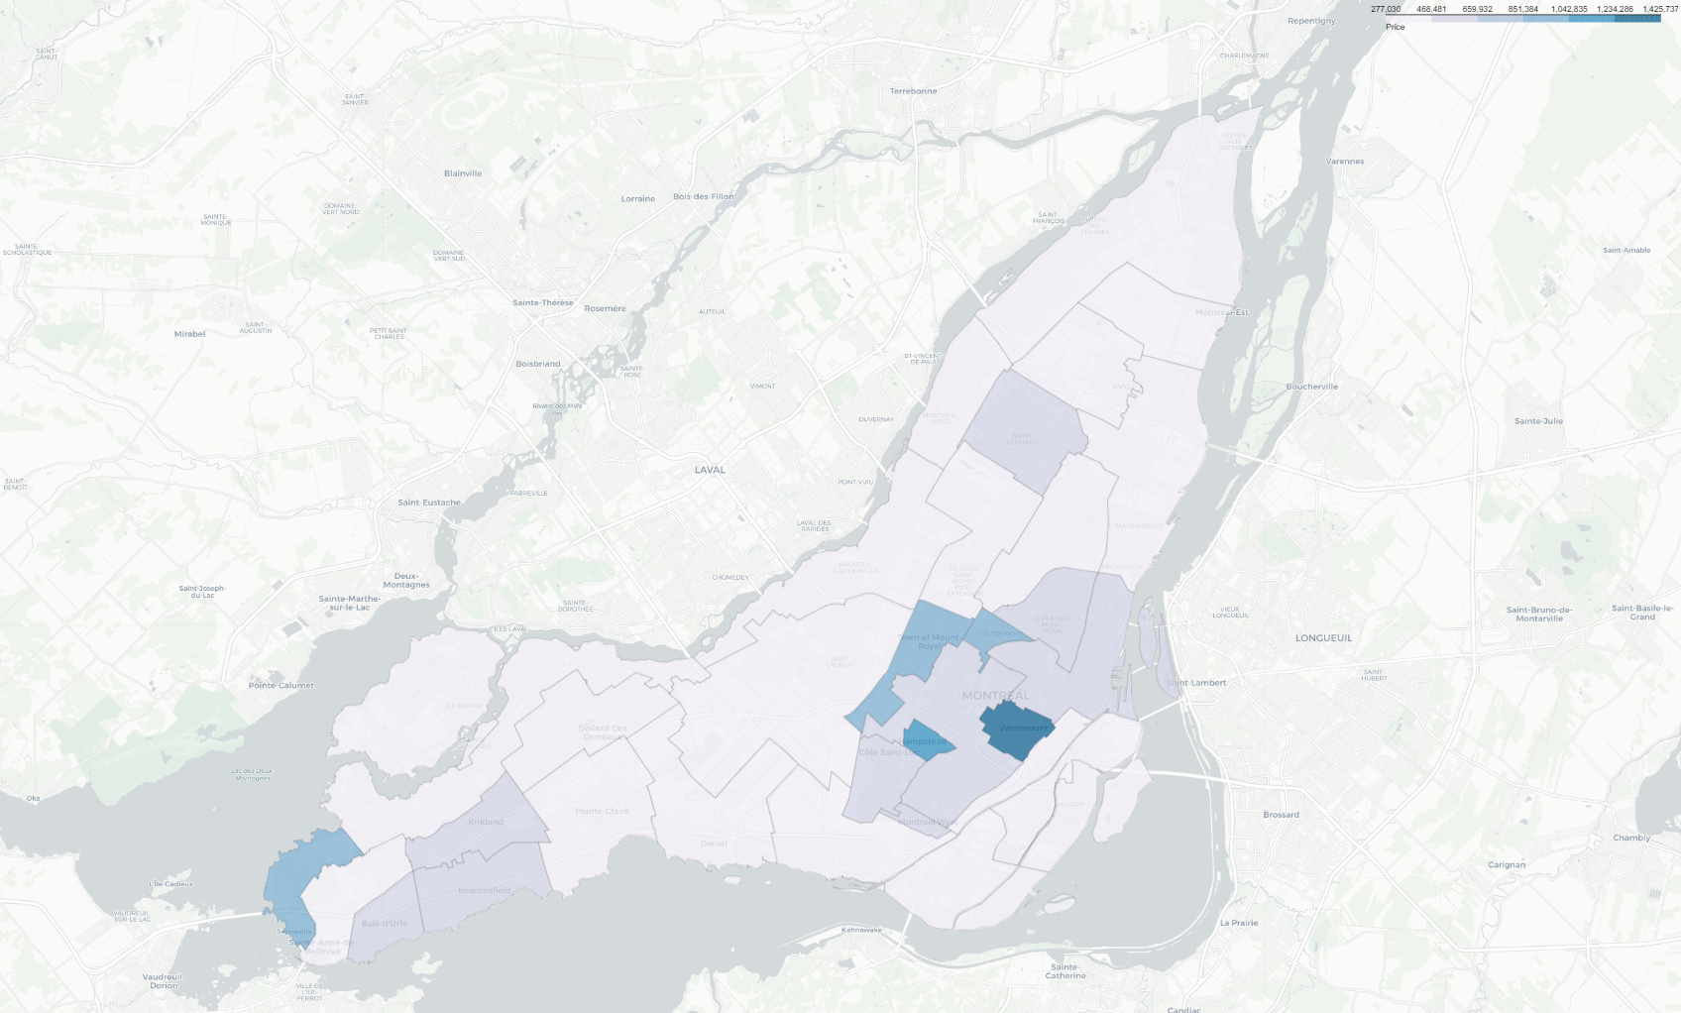
Real estate prices

Slide 11
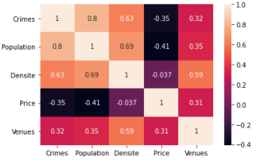
Observation
While correlations could be observed through the maps visualization, here’s is a correlation matrix that relates the several features of our datasets. Important to note a high(0.8) correlation between population and crimes. The least but also interesting to note is the density correlates with venues(although at only 0.59).

Slide 12
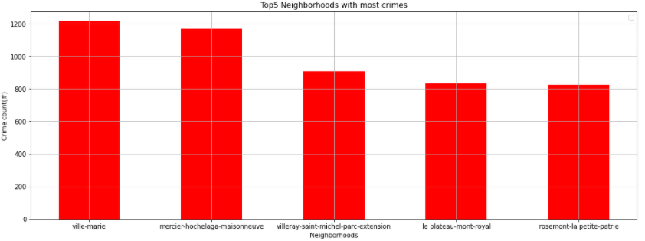
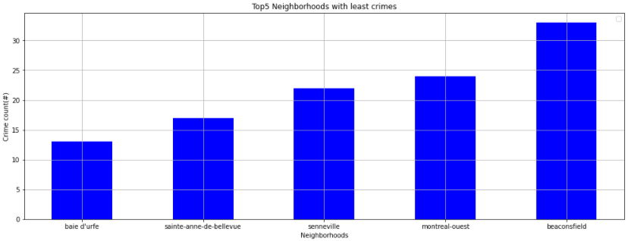
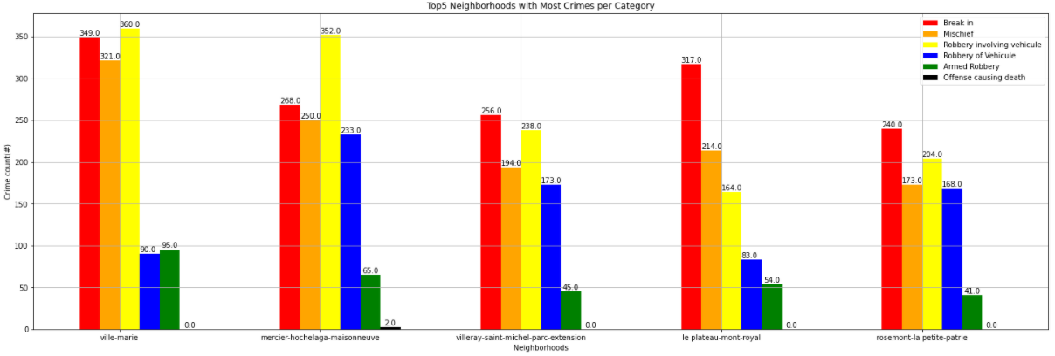
Criminality
For a better understanding, the crime dataset covers the last 6 months of year 2020. The data offers 5 type of criminal activities as seen below. We’ve took the 5 top and bottom active neighborhoods. So far, the correlation with population is strong. The same was observed with venues and population.

Slide 13
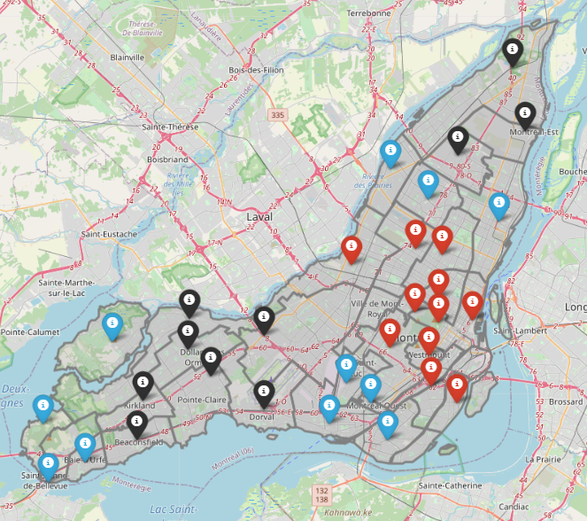
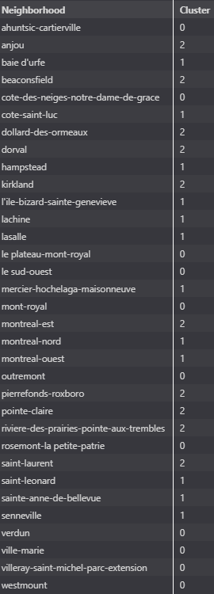
Clustering
Cluster 0 = Red
Cluster 1 = Blue
Cluster 2 = Black

Slide 14
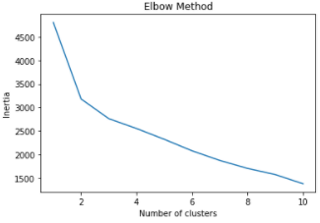
Clustering
As part of the clustering, the optimal # of cluster was 3. The methods was only done on venues data. We can observe similarities between the clustering process and the crime/population features.
Method for cluster optimization with Inertia value.

Slide 15
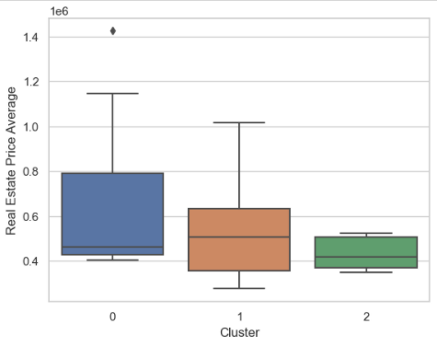
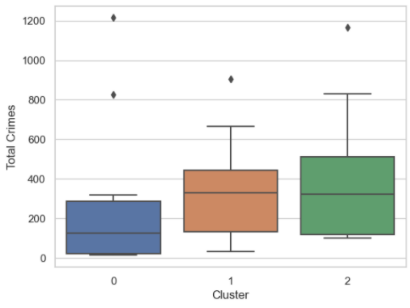
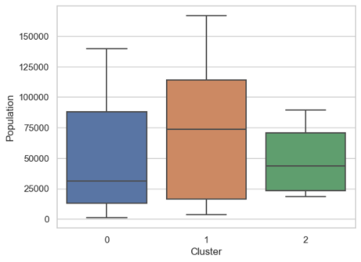
Clusters against features
3
1
2
Clusters are based on venues repartition and occurrences. We’ve done so to have it as a baseline of our analysis. Here, we see the boxplots our clusters, covering real estate price average, total crimes and population count. Observation#1 points on a low and close repartition of real estate prices within the cluster 2. Observation#2 points out on a low and fairly spreaded crimes counts across cluster1(a few exceptions). Observation#3 analyze the correlation between population and crimes which are seeing less through our clustering.

Slide 16
Conclusion
The analysis we’ve done observed multiple correlations and possible trade-offs required when selecting a neighborhood or even a cluster(of neighborhoods).
We’ve observed a clustering excessively relative to the proximity of the neighborhoods. This is explained by the same venues listed per Neighborhoods since they are within a certain radius. This is a good thing to leverage the proximity as part of our clustering. Definitely applicable for our Cluster#0, the other clusters are segmented either in 2 or 3 groups.
As low cost option, anywhere within Cluster#2 is cheap and well surrounded by various venues. While this same cluster occupies a range of criminal activities, Beaconsfield is the neighborhood with the least.
Westmount identified as part of Cluster#0 makes the difference with an average real estate cost near 1.5 million. The cluster has a median barely reaching the semi million. The criminality within the cluster is also low for having a median below 100 criminal activities within 6 months (note with a few exceptional neighborhoods).
What about Cluster#1 ? Well… It is a cluster which obviously regroups neighborhoods with varied venues(Café/Coffee Shops, restaurants and other convenience stores). However, the neighborhoods from the west island are not sharing the same criminal records compared to the others. As an example, Baie d’Urfe, Senneville, Sainte-Anne de Bellevue are the neighborhoods with the least criminal activities.
As a result, our clustering process helped on grouping neighborhoods similar in terms of venues and we’ve used the boxploting on verifying the pattern with our other datasets. The decision is yours and depends on how much you can afford and how much you rate the risk of criminality within the neighborhood.

